Slide 1

Title: University attendance system using face recognition
Student Name: Shawon Roy
Student ID: P2713741
Supervisor: DR. amal al shargabi
Date: 24th May 2024

Slide 2
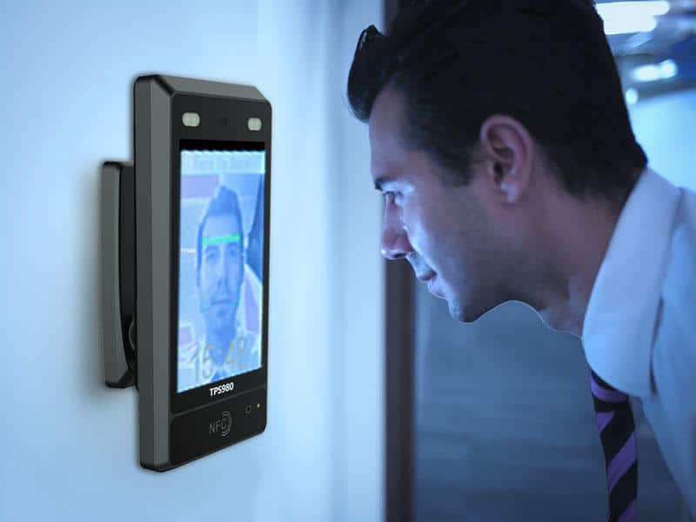
Introduction
This project aims to develop an intelligent face recognition system to improve the accuracy and security of attendance tracking. By utilizing a CNN-based model, it addresses the shortcomings of non-biometric systems.
Figure-1: A biometric system

Slide 3
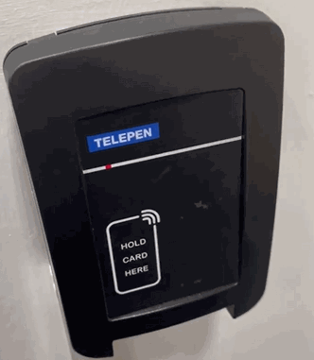
Problem finding
This project seeks to address the limitations of my university's tap-on attendance system, which currently lacks biometric verification, leading to potential proxy attendance. The goal is to create a solution that mitigates this issue and ensures ethical and accurate attendance tracking.
Figure-2: Tap On Attendance System

Slide 4
Literature Review
Face Recognition-Based Attendance System
Class Attendance System (IoT-Based)
Smart School Attendance System (Near Optimal Imaging)
Automatic Attendance System (Deep Learning Techniques)
  This system employs a four-step process: online enrollment, image processing, deep learning, and attendance marking. The Eigen algorithm is used to minimize errors and proxy attendance. Future work includes geolocation integration for remote attendance.
  This IoT-based system
    incorporates five stages: face input, live image capture, face detection using the Haar-Cascade algorithm on a Raspberry Pi, data storage in Google Sheets, and instructor notifications. Planned improvements include HTTPS security, enhanced adaptability to lighting conditions, and controlled data access.
  Using a webcam and Raspberry Pi, this system records attendance through a web interface and stores data in CSV files. It employs the EBGM algorithm to identify students accurately. Future research will aim to improve classifiers by utilizing additional facial images.
  This system uses a three-step process for video capture, face recognition, and attendance logging. It integrates multiple algorithms (VGG Face, OpenFace, Facenet, etc.) for high accuracy in facial recognition. Further research will focus on integrating VGG-Face and Facebook DeepFace for improved recognition metrics.

Slide 5
Summary of methodology
Dataset: The "Labeled Faces in the Wild" (LFW) dataset comprises over 13,000 facial images from more than 5,700 individuals, featuring variations in lighting, poses, and expressions. It provides realistic and challenging conditions to rigorously train and test the face recognition model's generalization capabilities.
Preprocessing: In the preprocessing phase, images are first loaded, decoded into a standard format, and resized to 105x105 pixels to standardize input dimensions. The images are then normalized by scaling pixel values to a range between 0 and 1, enhancing neural network training efficiency and model performance. This sequence ensures the model receives uniformly prepared data for accurate face recognition.
Structure of Neural Networks: Convolutional Neural Networks (CNNs) are adept at processing grid-like data such as images. These networks include convolutional layers that extract features using filters, pooling layers that reduce spatial dimensions to decrease computational load, and fully connected layers that integrate and classify these features using a MaxPolling function. This structure allows CNNs to effectively perform image recognition by learning from visual data in a hierarchical manner.
Data Portioning: The dataset is divided into a training set (70%, or 140 out of 200 images) and a testing set (30%). Training data is processed in batches and preloaded for efficiency to ensure smooth operation during model training.

Slide 6
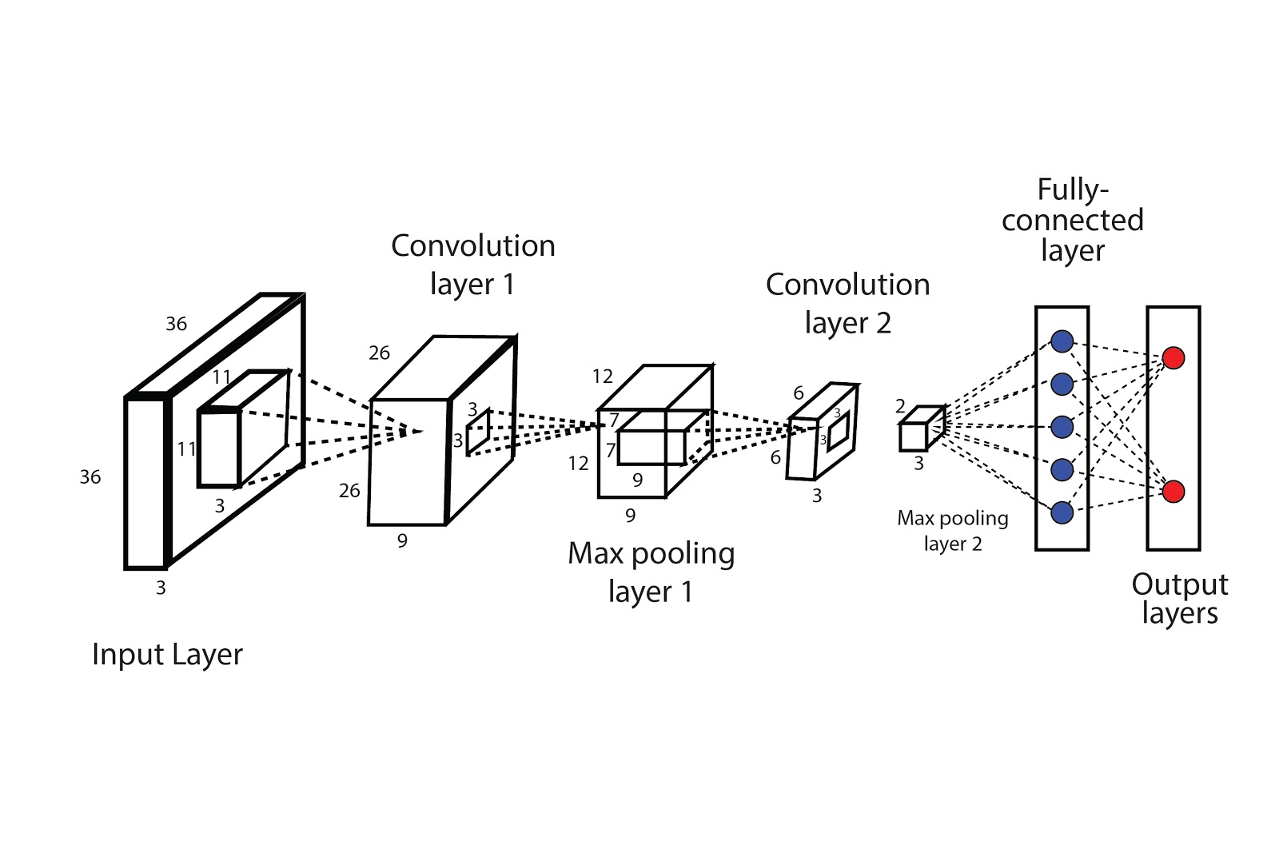
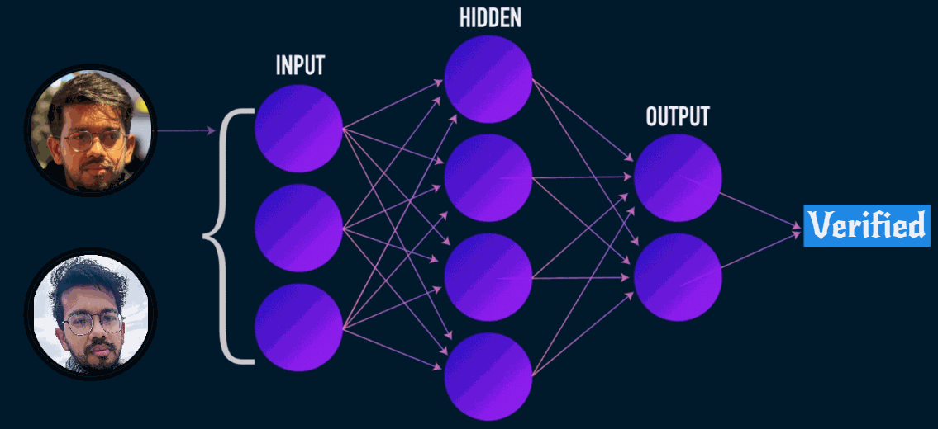
DESCRIPTION of THE NUERAL NETWROK’S LAYERS
Input layer: The network receives images with dimensions of 105x105 pixels across three color channels.
Convolutional layer : The architecture includes four convolutional layers with progressively increasing filter counts (64, 128, 128, 256) and decreasing kernel sizes (10x10, 7x7, 4x4). Each layer employs ReLU activation to introduce non-linearity, facilitating the extraction of complex features.
Pooling layer : Successive to the first three convolutional layers, three max pooling layers with a 2x2 kernel are applied. These layers serve to reduce the spatial dimensions of the feature maps, thereby decreasing the computational load and enhancing the extraction of dominant features.
Output layer : A flattening operation converts the multi-dimensional output of the final convolutional layer into a one-dimensional vector, which is then passed to a dense layer.
Dense layer: This layer consists of 4096 units with sigmoid activation, produces the final embeddings, encapsulating the high-level features derived from the input image.
Figure-3: Structure of the Convolutional Neural Networks
Figure-4: Verification visualization

Slide 7
Image Collection: Gather a variety of images to train the model, ensuring diverse facial representation.
Image Resizing: Resize images to conform to the CNN's required pixel specifications for consistent processing.
CNN Architecture: Construct layers in the CNN to extract and distinguish facial features effectively.
Model Training: Train the model using the prepared images to learn distinct facial recognition patterns.
Real-Time Testing: Evaluate the model's performance in real-time to assess its accuracy in various conditions.
System Implementation

Slide 8
Critical reflection
  Strengths:
  Effective for basic recognition tasks.
  Provides foundation for further features integration
Limitations:
Neural Network Simplicity: The current model uses a basic neural network, which limits accuracy and detail recognition. Implementing more complex architectures could enhance performance by capturing finer facial distinctions.
Single Image Processing: The system can only verify and store one image at a time. This restricts its usability in scenarios requiring simultaneous multiple verifications, as each new image replaces the previous one.

Slide 9
Future ImprovemEnt
Enhance Neural Network: Employing more advanced convolutional techniques to improve accuracy and generalization.
Expand Image Handling: Modifying the system to process multiple images concurrently to meet the demands of high-traffic environments.
IoT Integration: Implementing IoT capabilities for seamless connectivity and real-time processing.
External Database Integration: Utilizing external databases like Redis and Excel for robust attendance storage and management.
Automated Alerts: Developing functionality to send alerts to students' registered emails for attendance verification and updates.

Slide 10
Thank you

